Slide 1
Property

Slide 2
Property Rights
Property is either classified as private property owned by one or more individuals, or public property owned by government.
The Constitution Act , 1867, gave legislative power over property and civil rights to the provinces.
Notes:
Property is either classified as private property owned by one or more individuals, or public property owned by government.
The Constitution Act , 1867, gave legislative power over property and civil rights to the provinces.
Parliament may incidentally affect property rights through legislation regulating interprovincial or international trade and commerce, through its power of taxation and through its power of expropriation. Nevertheless, general property law is the preserve of the provincial legislatures.

Slide 3
Property Rights
Everyone has the right to own property alone as well as in association with others.
No one shall be arbitrarily deprived of his property.
Notes:
Everyone has the right to own property alone as well as in association with others.
No one shall be arbitrarily deprived of his property.
Property rights are also recognized in the 1960 Canadian Bill of Rights, which affirms the right of the individual to the enjoyment of property and the right not to be deprived thereof except by due process of law. However they are not recognized in our Constitution.

Slide 4
Charter of Rights
Although the Canadian Charter of Rights and Freedoms does not expressly protect property rights, such rights are created and are therefore protected by both common law and by statute law — although both can be changed by legislation.
Notes:
Although the Canadian Charter of Rights and Freedoms does not expressly protect property rights, such rights are created and are therefore protected by both common law and by statute law — although both can be changed by legislation.

Slide 5
Deeds and Land-Titles
In southern Ontario, there is a deed registration system.
Many of the beach owners on East Parkway Rd deeds clearly states the property extends to the approximate edge of the water
Notes:
In southern Ontario, there is a deed registration system.
Under the deed registration system, individuals establish ownership to land derivatively through their predecessors in title. Theoretically, to establish ownership they should trace the title to the original grant of the land from the Crown. In southern Ontario, it is necessary now to show a good root of title dating back 40 years
Many of the beach owners on East Parkway Rd deeds clearly states the property extends to the approximate edge of the water

Slide 6
History 101
Brief overview of the settling of Ipperwash

Slide 7
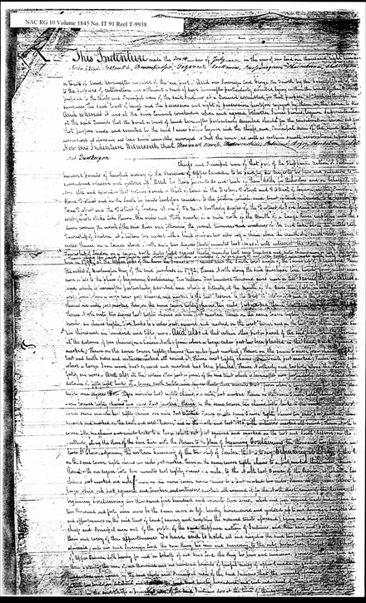
Treaty #29, 1827
Notes:
Following the War of 1812 the British wanted to settle European immigrants in Upper Canada. They approached the Chippewa asking them to cede their land. The land cession treaty was negotiated over a nine-year period from 1818 to1827.

Slide 8
The Surrendered Tract
Notes:
18 Chippewa chiefs ceded over2.1 million acres by the Huron Tract Treaty of1827. They received a perpetual annuity of £1,100 (about$4,400 or $10 per person per year)

Slide 9
1927 Crawford/White Land Purchase From the Kettle Point Reserve
Notes:
In 1927 part of the beach front of the Kettle Point Reserve was surrendered for sale. Men from both Kettle and Stony Point voted on the surrender and 83 acres were sold at $85 per acre. This represented about 3% of the land base at Kettle Point.
This surrender became the subject of a law suit and land claim against Canada in the1990s. It has not yet been resolved.

Slide 10
1928 Scot Purchase From the Stony Point Reserve
Notes:
In 1928 the entire beach-front of the Stony Point Reserve was surrendered for sale. Men from both Kettle and Stony Point voted on the surrender and 377 acres were sold at $35 per acre. This represented about 14% of the land base at Stony Point.
• This surrender became the subject of a land claim against Canada in 1996. And has been returned to the Kettle and Stony Point Band.

Slide 11
AREA PURCHASED FOR IPPERWASH PROVINCIAL PARK IN 1932•
Notes:
The Province of Ontario purchased a portion of the surrendered Stony Point beach front and established Ipperwash Provincial Park in 1932.

Slide 12
Title Insurance
Title insurance is a policy issued by an insurance company guaranteeing that the title to a parcel of real property is clear of any claims or liens and properly in the name of the title owner and that the owner has the right to sell or otherwise transfer the property to another.
Notes:
Title insurance is a policy issued by an insurance company guaranteeing that the title to a parcel of real property is clear of any claims or liens and properly in the name of the title owner and that the owner has the right to sell or otherwise transfer the property to another. The insurance company will pay the damages to the new title holder or secured lender or take steps to correct the problem if a problem with the property ownership is later discovered, such as an incorrect boundary description.
Title insurance covers problems that did not show up during the title search or were missed by the examiner and errors in public records. Title insurance does not cover defects that occur after you purchase the property. Policies often exclude problems having to do with easements, mineral and air rights, and liens.

